Slide 1

Course Name: Hardware Security
Faculty Name: Prof Debdeep Mukhopadhyay
Department : Computer Science and Engineering
Topic
Lecture 03: Algorithm to Hardware

Slide 2

Concepts Covered:
Data-Path & Control-Path
Identification of Data-Path elements
Control Path Design
Data-Path and Control-Path design of gcd processor
Performance modeling on FPGAs

Slide 3

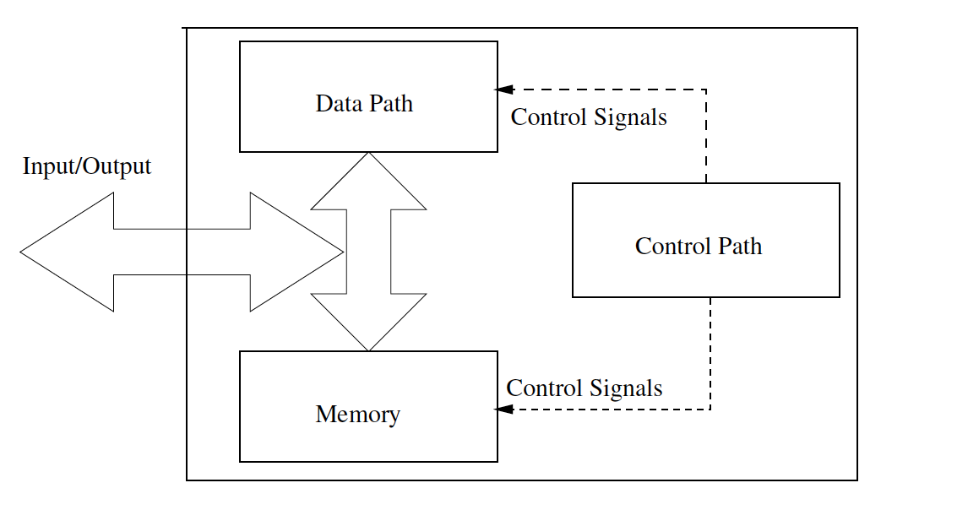
Mapping an Algorithm to Hardware
Conversion of an algorithm to an efficient hardware is a challenging task: Performance is a key-decider.
For an efficient design, one needs to:
Understand the components of a hardware design
Understand the architecture of the design
Data-path elements are the computational units of the design
Control-path elements sequence the data flow through the data-path elements.

Slide 4
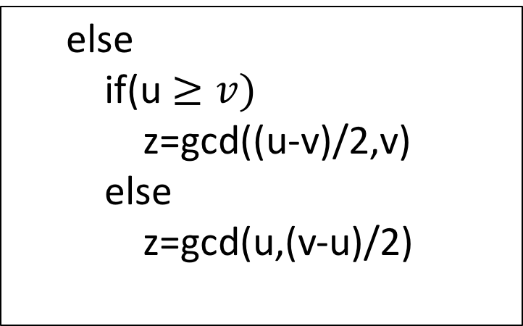
Case Study: Binary gcd processor
Input: Integers u and v
Output: Greatest Common Divisor of u and v, z=gcd(u,v)
while (u!=v) do
If (u and v are even)
z=2gcd(u/2,v/2)
else if (u is even and v is odd)
z=gcd(u/2,v)
else if(u is odd and v is even)
z=gcd(u,v/2)
else
if(u $≥v)$
z=gcd((u-v)/2,v)
else
z=gcd(u,(v-u)/2)
We need to realize a co-processor on FPGA to compute gcd of two given numbers
References: Hardware Security: Design, Threats, and Safeguards, CRC Press.

Slide 5
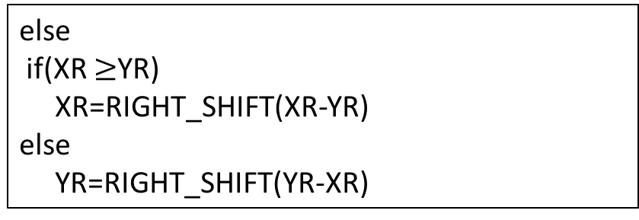
Identification of the States of the Algorithm
Input: Integers u and v
Output: Greatest Common Divisor of u and v, z=gcd(u,v)
register u and v
XR=u, YR=v, count=0
while (XR!=YR) do
If (!XR[0] and !YR[0])
XR=RIGHT_SHIFT(XR)
YR=RIGHT_SHIFT(YR)
Count=Count+1
else if(XR[0] and !YR[0])
YR=RIGHT_SHIFT(YR)
else if(!XR[0] and YR[0])
XR=RIGHT_SHIFT(XR)
State 2
State 3
State 0
else
if(XR $≥$YR)
XR=RIGHT_SHIFT(XR-YR)
else
YR=RIGHT_SHIFT(YR-XR)
State 4
State 1
while(count > 0)
XR=LEFT_SHIFT(XR)
count=count-1
State 5
References: Hardware Security: Design, Threats, and Safeguards, CRC Press.

Slide 6
Identification of the Data Path Elements
Subtractor
Complementer
Right Shifter
Left Shifter
Counter
Multiplexer:
Required in large numbers for the switching necessary for the computations done in the datapath.
Selection lines in the multiplexer are configured by the control circuitry, which is essentially a state machine.
References: Hardware Security: Design, Threats, and Safeguards, CRC Press.

Slide 7
Identification of the State Machine of the Control Path
Control Path is a sequential design.
It can be represented by a state machine.
In this example, there are 6 states.
The controller receives inputs from the partial computations of the datapath.
Based on the current state and input, it performs state transitions.
It also produces control signals which configures the datapath elements or switches the multiplexers to sequence the dataflow.
References: Hardware Security: Design, Threats, and Safeguards, CRC Press.

Slide 8
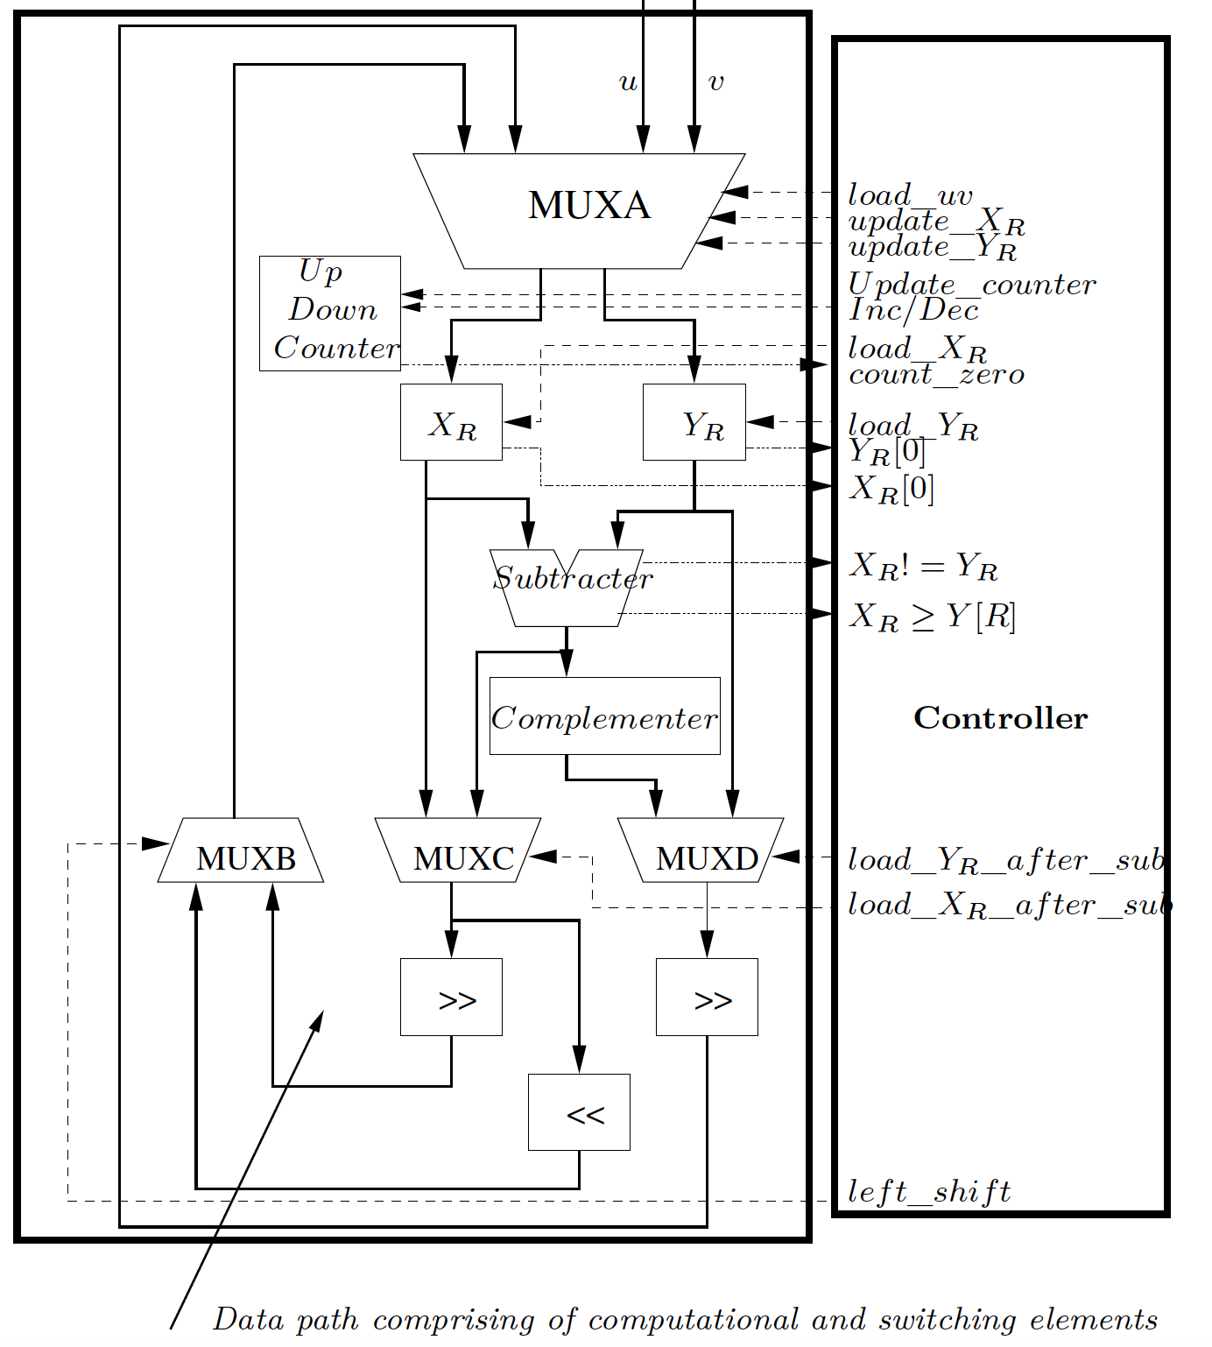
Data Path Architecture
References: Hardware Security: Design, Threats, and Safeguards, CRC Press.
The data-path stores the value of XR and YR in two registers.
Registers are loadable, ie. XR is updated when say load_XR is high.
Values of u and v are initially loaded through the input multiplexer, using the control signal load_uv.
Least bits of XR and YR are passed to the controller to indicate whether present values of XR and YR are even or not.
Next iteration values of XR and YR are fed back after needed computations, and this is controlled by the signal update_XR and update_YR.

Slide 9
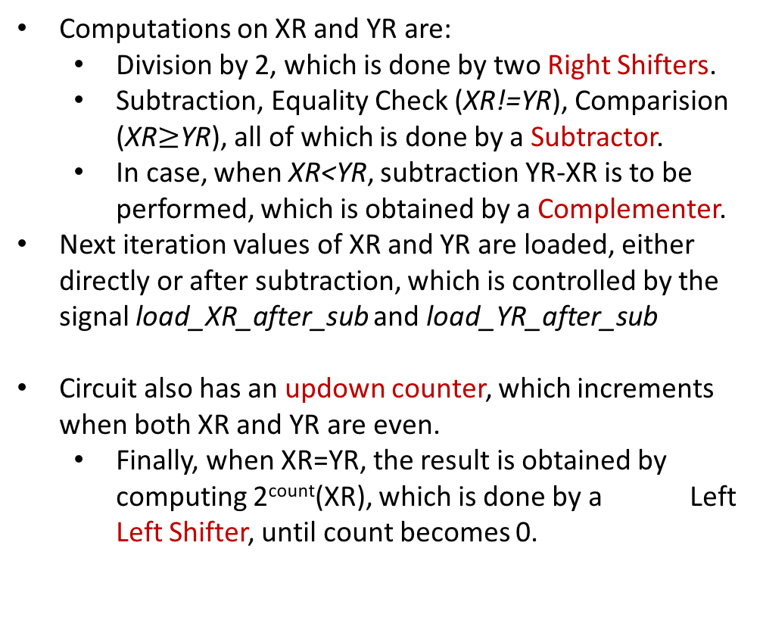
Data Path Architecture
Computations on XR and YR are:
Division by 2, which is done by two Right Shifters.
Subtraction, Equality Check (XR!=YR), Comparision (XR$≥$YR), all of which is done by a Subtractor.
In case, when XR<YR, subtraction YR-XR is to be performed, which is obtained by a Complementer.
Next iteration values of XR and YR are loaded, either directly or after subtraction, which is controlled by the signal load_XR_after_sub and load_YR_after_sub
Circuit also has an updown counter, which increments when both XR and YR are even.
Finally, when XR=YR, the result is obtained by computing 2^{count}(XR), which is done by a Left Left Shifter, until count becomes 0.

Slide 10
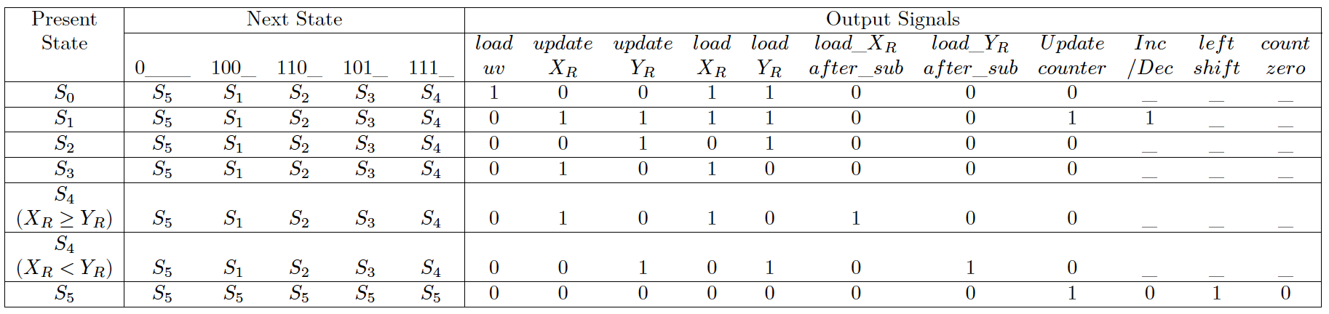
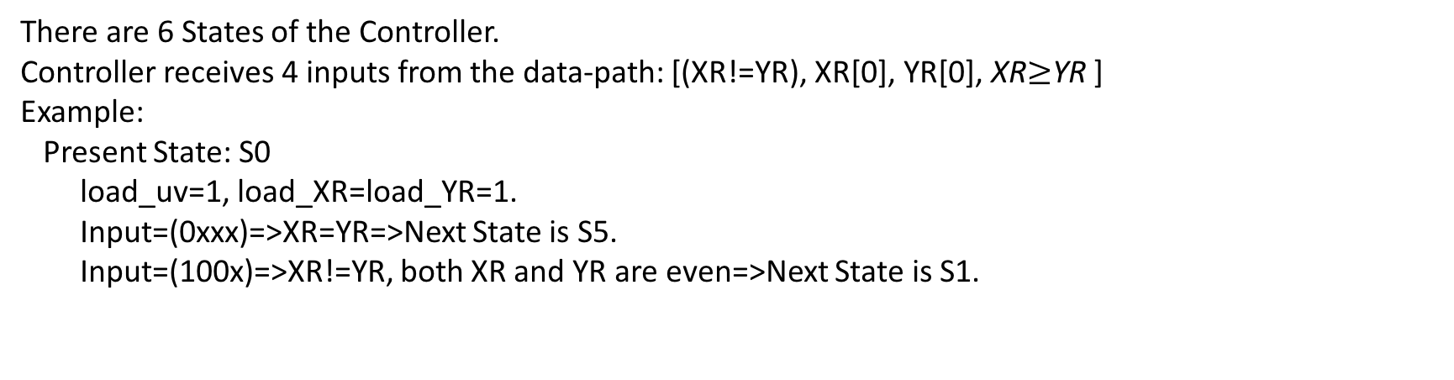
State Machine of the Controller
There are 6 States of the Controller.
Controller receives 4 inputs from the data-path: [(XR!=YR), XR[0], YR[0], XR$≥$YR ]
Example:
Present State: S0
load_uv=1, load_XR=load_YR=1.
Input=(0xxx)=>XR=YR=>Next State is S5.
Input=(100x)=>XR!=YR, both XR and YR are even=>Next State is S1.

Slide 11
State Machine of the Controller
Present State: S1
load_uv=0, load_XR=load_YR=1, update_XR=update_YR=1, Update Counter=1, Inc/Dec=1.
Input=(0xxx)=>XR=YR=>Next State is S5.
Input=(100x)=>XR!=YR, both XR and YR are even=>Next State is S1.
Input=(110x)=>XR!=YR, XR is odd, YR is even=>Next State is S2.

Slide 12
Performance Evaluation of the Design
One of the primary goals of developing a hardware design is performance.
But performance is context sensitive.
We revise some general definitions:
In a combinational circuit, the critical path delay is vital.
Synthesis tool assumes that all combinational paths in the design are to be performed in a single clock period.
Critical path is the maximum delay of a combinational path between two registers.
Critical path gives an upper bound to the clock frequency, f_{clk}, say f_{max}

Slide 13
Performance Evaluation of the Design (Contd.)
For a sequential circuit, like the gcd processor, number of clock cycles is also important.
In the gcd processor, the number of clock cycles vary with the input, and is proportional to the bit length of the bigger argument.
On an average, if the cycles required are cc_{avg}, then the total computation time is t_{c}=cc_{avg}/f_{max}
If the number of bytes of data being simultaneously processed is Nb, then the throughput of the hardware, is T=Nb/tc=Nb(fmax/ccavg).

Slide 14
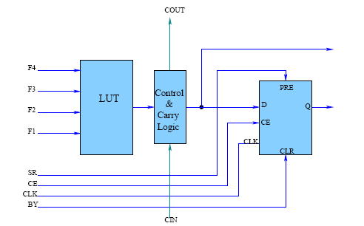
Resource Consumption
The other important aspect is resource consumed.
In context to FPGAs, the resources largely comprise of slices, which are made of LUTs, and flip-flops.
LUT Structure of Xilinx Virtex-4
Four Input , One Output.
Can contain 16x1 SRAM.
Can implement any four input truth table.

Slide 15
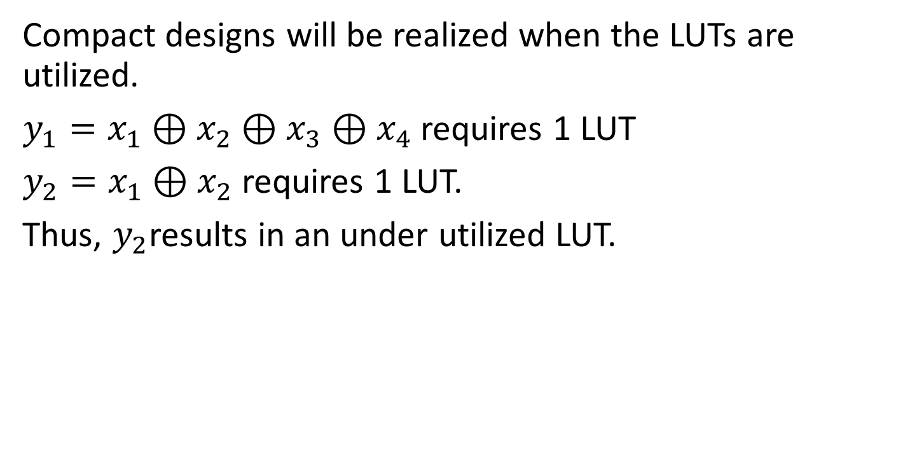
LUT Utilization
Compact designs will be realized when the LUTs are utilized.
$y_{1}=x_{1}⊕x_{2}⊕x_{3}⊕x_{4}$ requires 1 LUT
$y_{2}=x_{1}⊕x_{2}$ requires 1 LUT.
Thus, $y_{2}$results in an under utilized LUT.
Design goal is to reduce the number of under utilized LUTs

Slide 16
LUT Under Utilization
Minimum number of LUTs required for a q-bit combinational circuit
(for 4 input LUT)
Delay of a q-bit combinational circuit.
LUT_{k} denotes that k inputs out of 4 are used by the design block realized by the LUT.

Slide 17
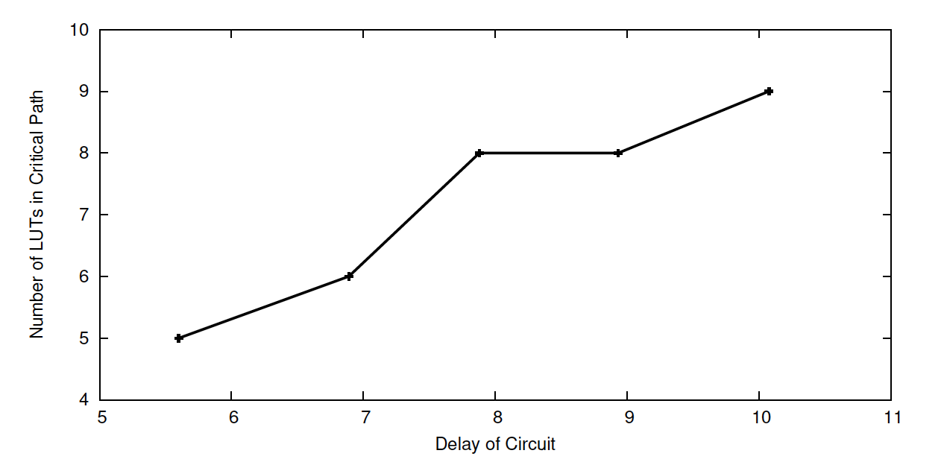
LUTs in Critical Path to Measure Delay
Delay in FPGAs comprise of both LUT and routing delay, and thus is more complex to analyze.
Through experiments one can however see that for combinational circuits, the delay varies linearly with the number of LUTs in the critical path.
Linear relationship between number of LUTs in Critical Path and Delay of a Combinational Multiplier of increasing dimensions.
References: Hardware Security: Design, Threats, and Safeguards, CRC Press.

Slide 18
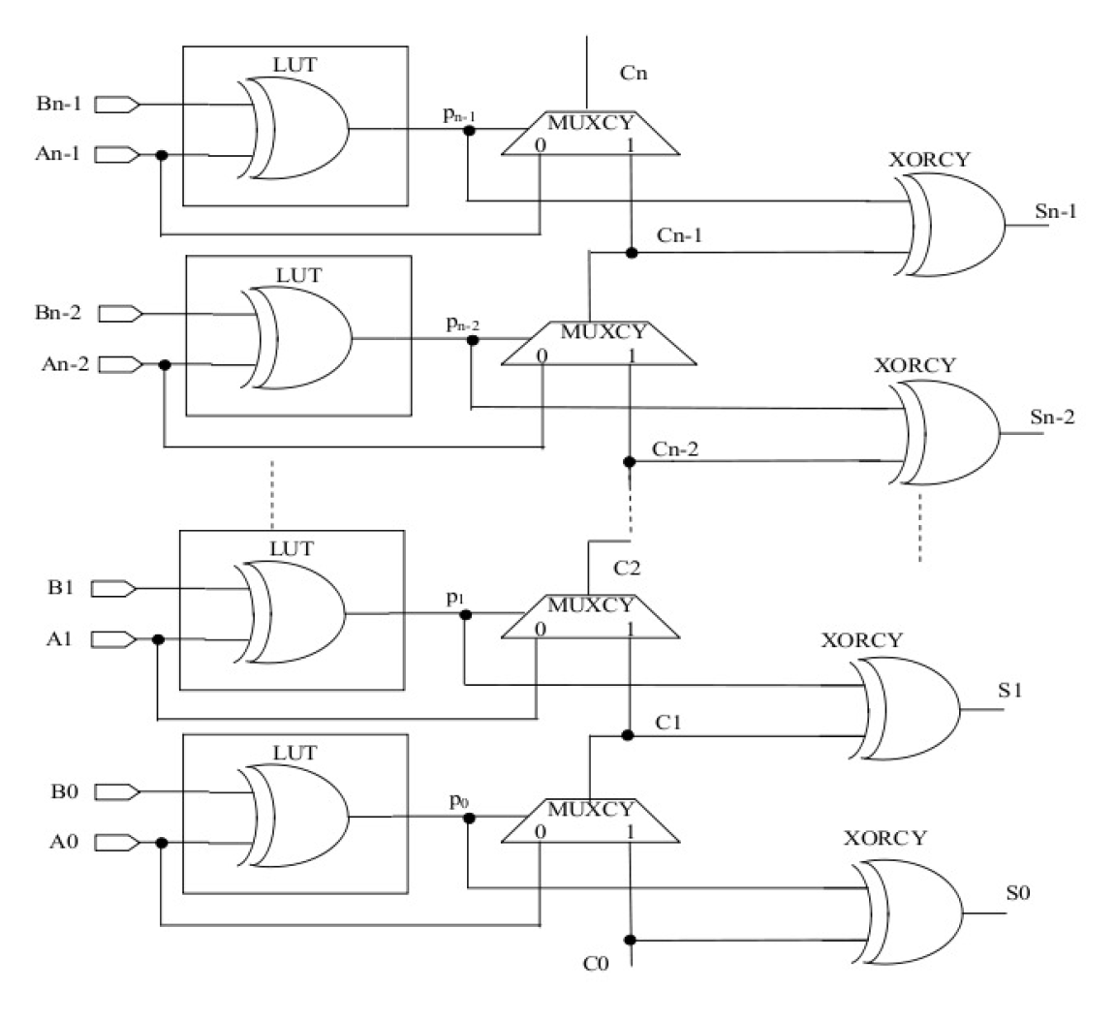
Modeling the Components of the gcd processor
Most important component in the data-path of the gcd processor is subtractor, which can be realized by an adder.
On FPGA platforms, carry chain based adder are specially optimized and are fast.
The carry chains use m-MUXCY for m-bit adder.
They are much faster compared to the LUTs which are used for other parts of the circuit.
So, in order to compare we scale the delay, and state:
For Xilinx Virtex IV FPGAs, s is almost 17.
References: Hardware Security: Design, Threats, and Safeguards, CRC Press.

Slide 19
Modeling the Multiplexer
2^{t}:1 Multiplexer: Output is a Boolean function of (2^{t}+t) variables.
So, for each bit output, it requires lut(2^{t}+t) LUTs.
For, an m-bit gcd multiplier, hence no. of LUTs is m* lut(2^{t}+t)
Delay: DMUX=

Slide 20
Total LUT Estimate of the gcd processor
Sum of the LUTs for MUXA, MUXB, MUXC, MUXD, and the subtractor along with the complementer (which is another subtractor).
The state machine is assumed to consume very less LUTs and is ignored.
Total number of 4-LUTs in the entire circuit:

Slide 21
Total Delay Estimate of the gcd processor

Slide 22
Total Delay Estimate of the gcd processor
Critical path of the design:
subtractor→complementer→MUXD→MUXB→MUXA.
Note that the delay of MUXA comes from the fact that the multiplexer is made of 2 smaller 2-input multiplexers in parallel: one input writing to XR, while the other writing to YR.

Slide 23
Experimental Exploration
The above design was synthesized using Xilinx ISE tools and targeted on a Virtex-4 FPGA.
Objective of the experiment was to study the above dependence on the LUT utilization and to estimate the critical path delay for the circuit.
The objective of the exploration is to see the trend, and not the exact figures.
We vary the bit length of the gcd processor, and repeat the experiments to study the scalability of the design.
This helps in design exploration, as we are able to understand the dependence and tweak the design early in the design cycle.

Slide 24
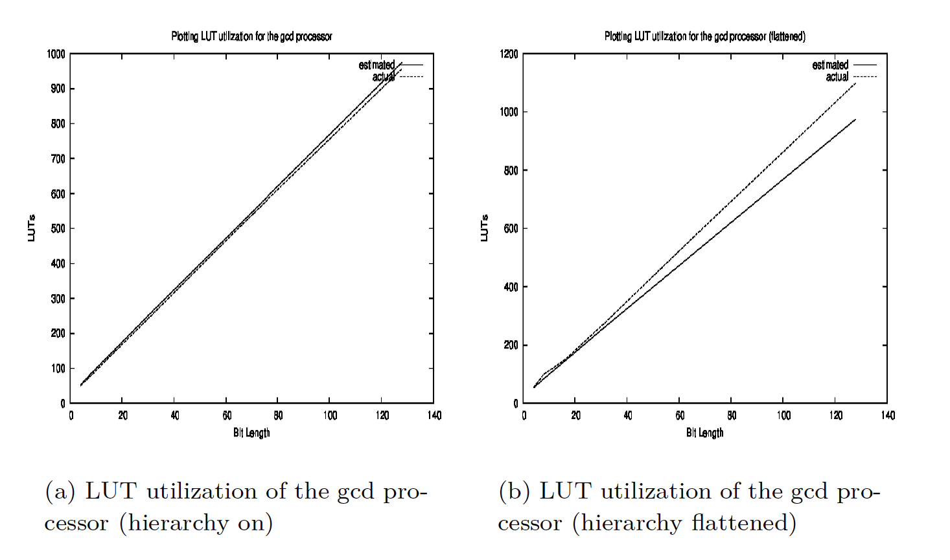
LUT utilization

Slide 25
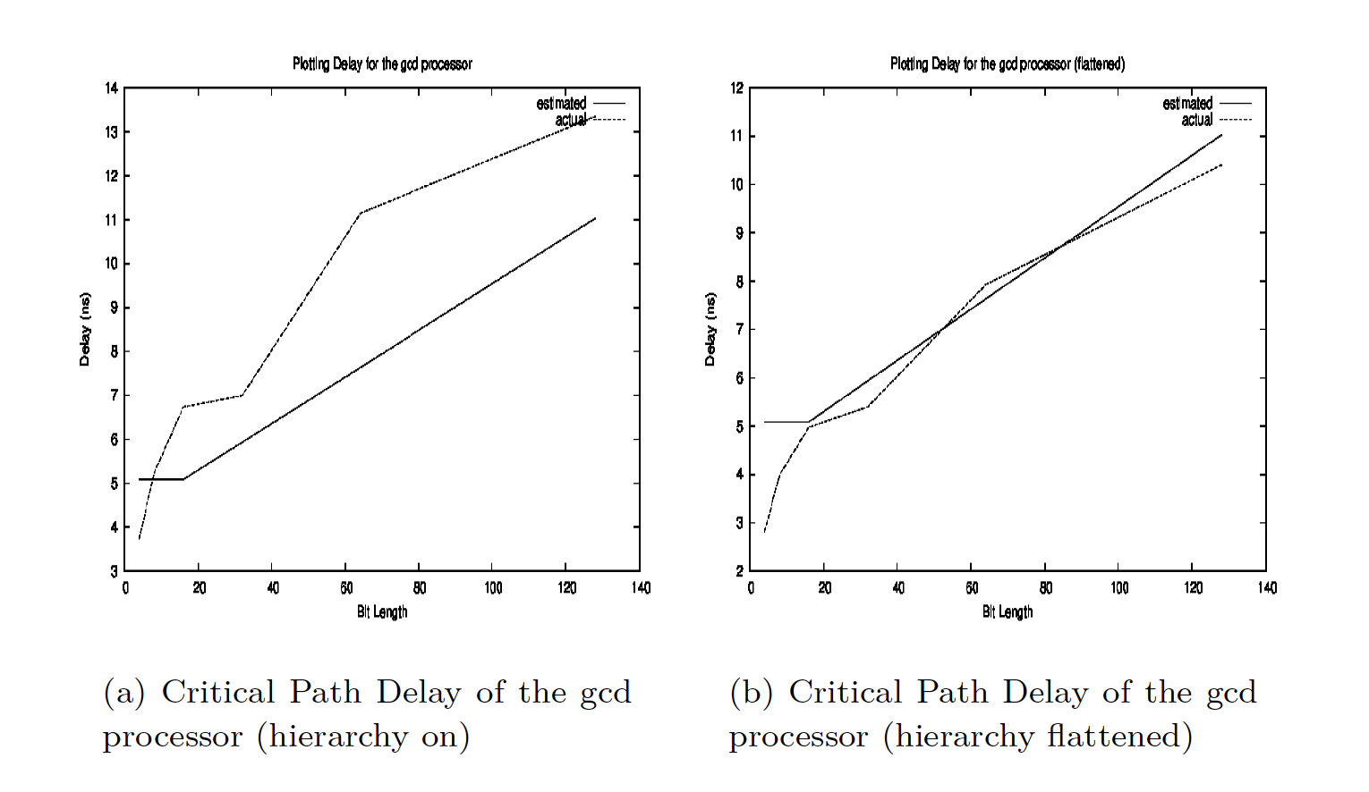
Delay Estimation

Slide 26


References:
Debdeep Mukhopadhyay and Rajat Subhra Chakraborty, Hardware Security: Design, Threats and Safeguards, CRC Press

Slide 27

Conclusion:
Proper division of data and control paths, is a key to design a hardware architecture for an algorithm.
Always start design with a nice architecture diagram: that is the 0th step of VLSI Design!
Performance modeling can be a useful tool to guide the exploration.
More than accurate estimations one can observe trends in the design which can be helpful to make early decisions

Slide 28


